Slide 1
Chongqing University of Technology
ATAI
Advanced Technique of Artificial Intelligence
Chongqing University of Technology
Graph Contrastive Learning with Adaptive Augmentation（WWW_2021）
Yanqiao Zhu, Yichen Xu, Feng Yu, Qiang Liu, Shu Wu, and Liang Wang,Center for Research on Intelligent Perception and Computing, Institute of Automation, Chinese Academy of SciencesSchool of Artificial Intelligence, University of Chinese Academy of Sciences School of Computer Science, Beijing University of Posts and Telecommunications Alibaba Group
yanqiao.zhu@cripac.ia.ac.cn, linyxus@bupt.edu.cn
yf271406@alibaba-inc.com, {qiang.liu, shu.wu, wangliang}@nlpr.ia.ac.cn
2021.5.18 • ChongQing
Reported by Lele Duan
Code:https://github.com/CRIPAC-DIG/GCA

Slide 2
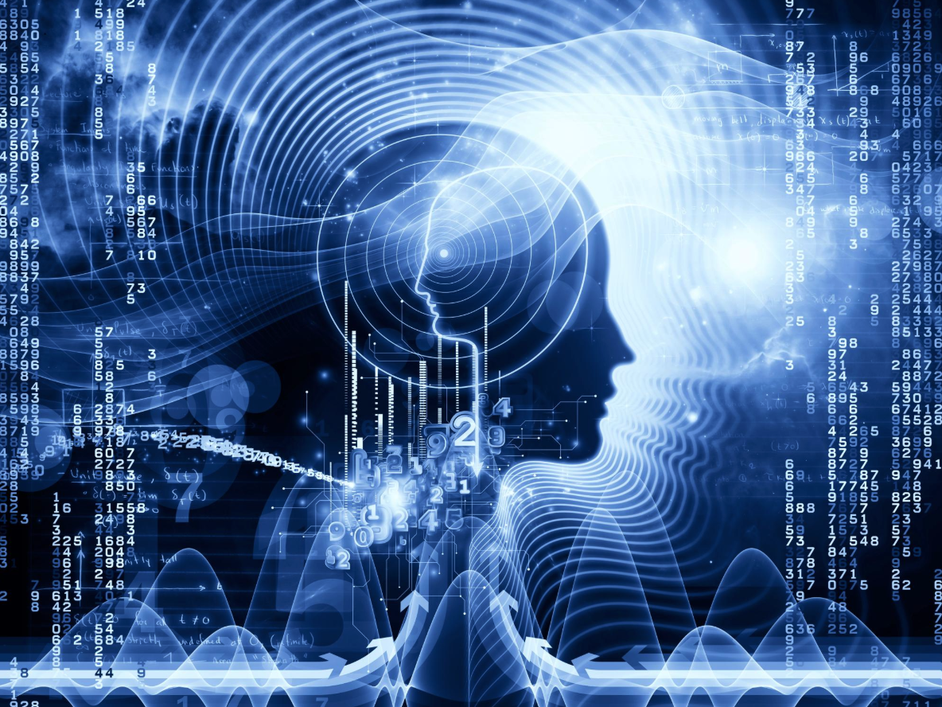
Chongqing University of Technology
ATAI
Advanced Technique of Artificial Intelligence
Chongqing University of Technology
1.Introduction
2.Method
3.Experiments

Slide 3
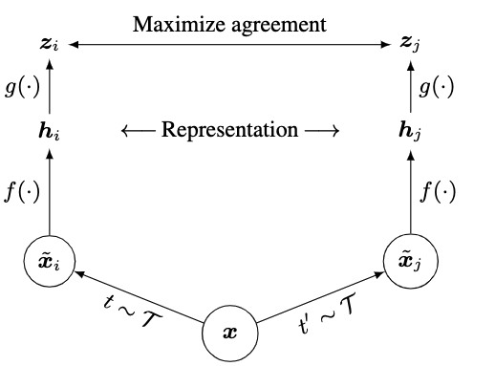
Introduction
Chongqing University of Technology
ATAI
Advanced Technique of Artificial Intelligence
对比学习：对比学习的目标是区分两个实例是否是由同一个源数据采样/增强得来，如果是，让它们在表示空间中越接近；如果不是，让它们在表示空间中远离。
SimCLR（2019）

Slide 4
Introduction
Chongqing University of Technology
ATAI
Advanced Technique of Artificial Intelligence
Contrastive learning (CL) has emerged as a successful method for unsupervised
graph representation learning
Performing stochastic augmentation on the input graph to obtain two graph views .
Maximizing the agreement of representations in the two views.
The design of graph augmentation schemes—a crucial component in CL—remains rarely explored.

Slide 5
Method
Chongqing University of Technology
ATAI
Advanced Technique of Artificial Intelligence

Slide 6
Method
Chongqing University of Technology
ATAI
Advanced Technique of Artificial Intelligence
GCA:
Firstly: sampling two stochastic augmentation function(Adaptive Graph Augmentation)
Topology-level augmentation:
we sample a modified subset from the original with probability:

Slide 7
Method
Chongqing University of Technology
ATAI
Advanced Technique of Artificial Intelligence
GCA:
Firstly: sampling two stochastic augmentation function(Adaptive Graph Augmentation)
Node-attribute-level augmentation:
First sampling a random vector where
Then, the generated node features is computed by：
The probability $p_{e}$ and $p_{f}$ is different for generating the two views. denoted by and respectively

Slide 8
Method
Chongqing University of Technology
ATAI
Advanced Technique of Artificial Intelligence
GCA:
Secondly:
Generating two graph views,
Denoting node embeddings in the two generated views as and
GNN：

Slide 9
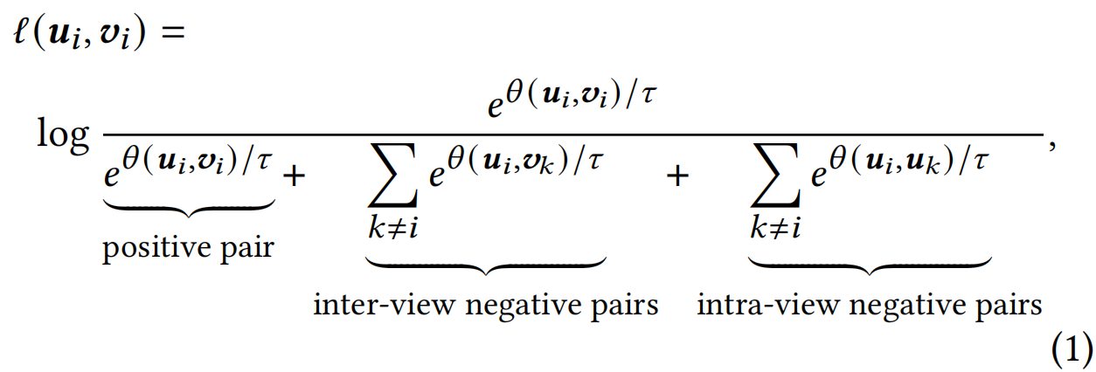
Method
Chongqing University of Technology
ATAI
Advanced Technique of Artificial Intelligence
GCA:
Finally: employ a contrastive objective.
Positive sample: ($u_{i},v_{i}$)
Negative sample:{($u_{i},v_{j}$),($u_{i},u_{k}$) $| i≠j,j≠k\}$
Defining the pairwise objective for each positive pair $(u_{i},v_{i})$ as:
: a two-layer perceptron model.

Slide 10
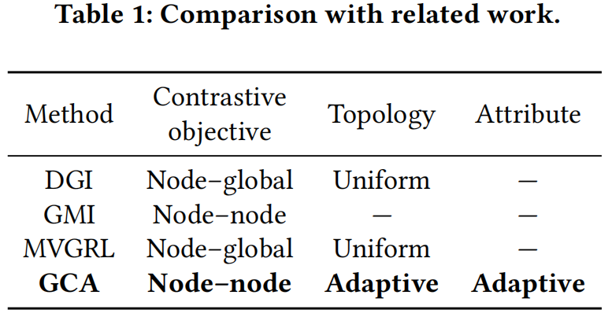
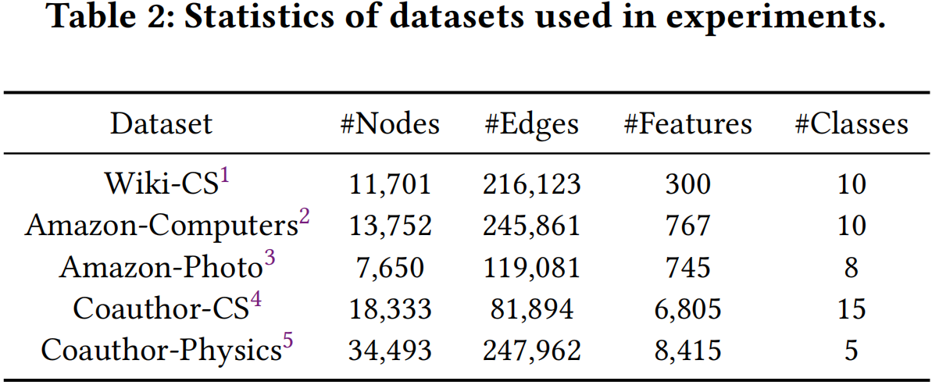
Chongqing University of Technology
ATAI
Experiments
Advanced Technique of Artificial Intelligence

Slide 11
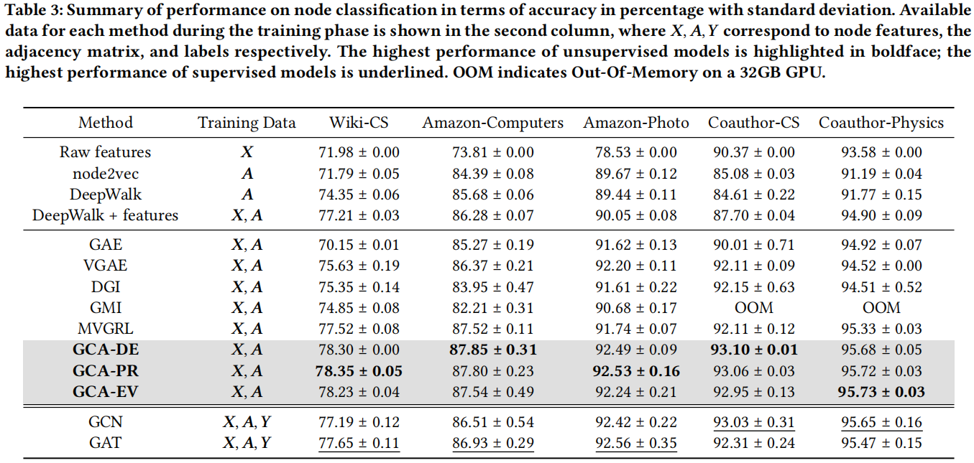
Experiments
ATAI
Chongqing University of Technology
Advanced Technique of Artificial Intelligence

Slide 12
Experiments
ATAI
Chongqing University of Technology
Advanced Technique of Artificial Intelligence

Slide 13
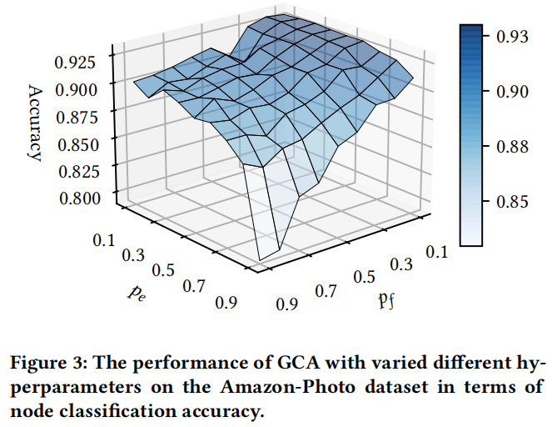
Experiments
ATAI
Chongqing University of Technology
Advanced Technique of Artificial Intelligence

Slide 14
Chongqing University of Technology
ATAI
Advanced Technique of Artificial Intelligence
Chongqing University of Technology
Thank you!

